Slide 1
Collaborative Networks

Slide 2

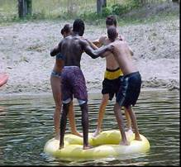
Introduction to collaboration networks
An alliance constituting a variety of organizations:
  Largely autonomous, and geographically distributed,
  Heterogeneous (operating environment, culture, social capital)
  Collaborate to better achieve common goals,
  Interactions are supported by the computer networks
Why collaboration:
  Effectively achieving common goals
  Provision of cost effective solutions
  Complementation for competencies and resources
  Sharing of risks
Differentiating aspects of collaborative networks:
  Structural forms
  Duration
  Behavioral patterns
  Interaction forms

Slide 3
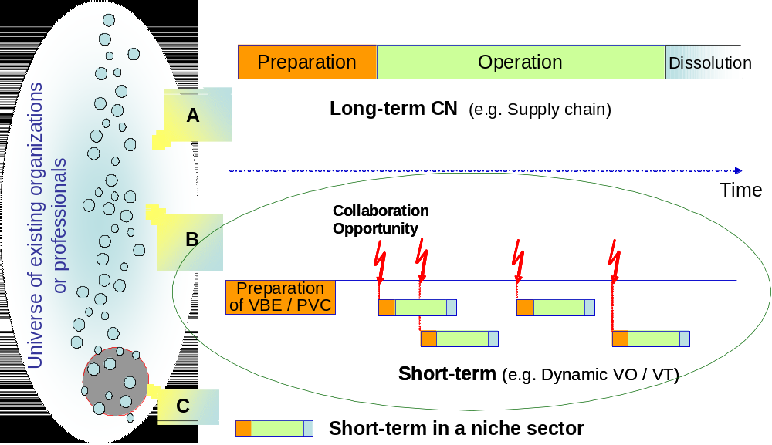
Establishing short term collaborative networks

Slide 4
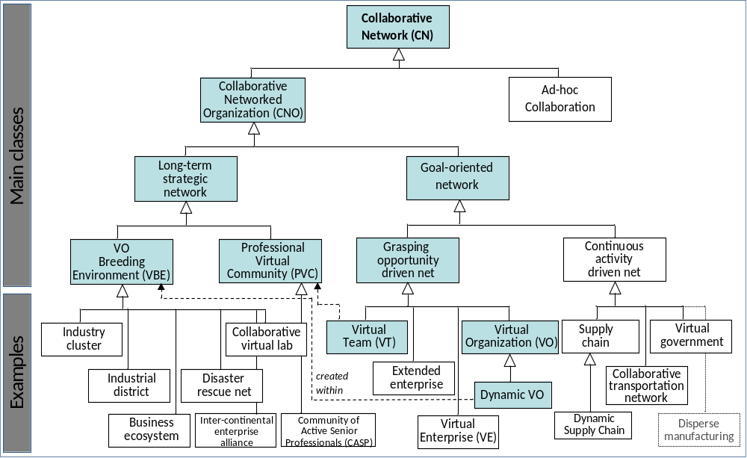
Classes of collaborative networks

Slide 5
Long term strategic alliances– The VBE
VBE
VO
An association of organizations
and related supporting institutions,
adhering to a
base long term cooperation agreement,
and adoption of
Common operating principles and infrastructures,
with the main goal of
increasing their preparedness
towards collaboration
in potential Virtual Organizations
VBE
Open Universe

Slide 6
Operational aspects of CNs – Legal aspects
How to legalize a virtual business entity?
Who should be accountable for such entity?
How to handle tax issues ?
  Should the network pay the taxes?
  Should the members pay the taxes?
How to handle the issues of intellectual property rights?
  Should the network hold them?
  Should the members hold them?
What form of an organization will it be?
  What organizational structure should it be?

Slide 7
Operational aspects of CNs – Governance
Who should lead such a network and what power will he/she have over the members?
  Members are not obliged to obey network leaders!
How will the leaders be obtained and how long will they stay in power?
  Members can join and leave the network at any time!
What will be the governance principles?
What form of an organization will it be?
  Which managerial bureaucracy should be followed?

Slide 8
Operational aspects of CNs – Economy and finance
How to share the profit, loss and risks resulted in collaborations?
  Depending on contributed capital?
  Depending on results’ contribution?
How to facilitate negotiations and contracting?
  Among partners?
  With the customer?
How to handle the financial and accounting issues?
  Considering the legal aspects of the network
  Considering the governance issues
….

Slide 9
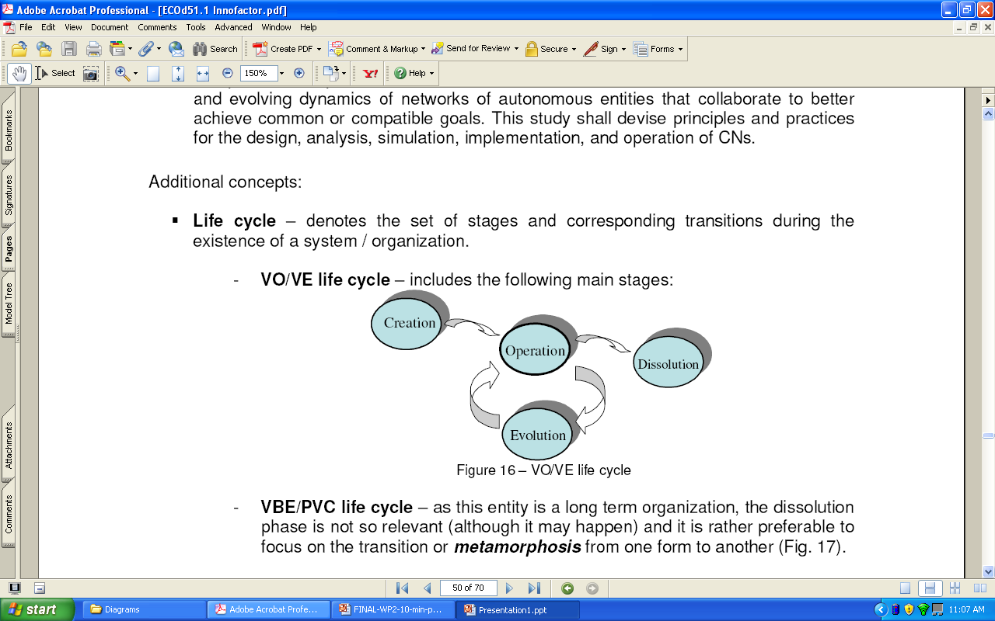
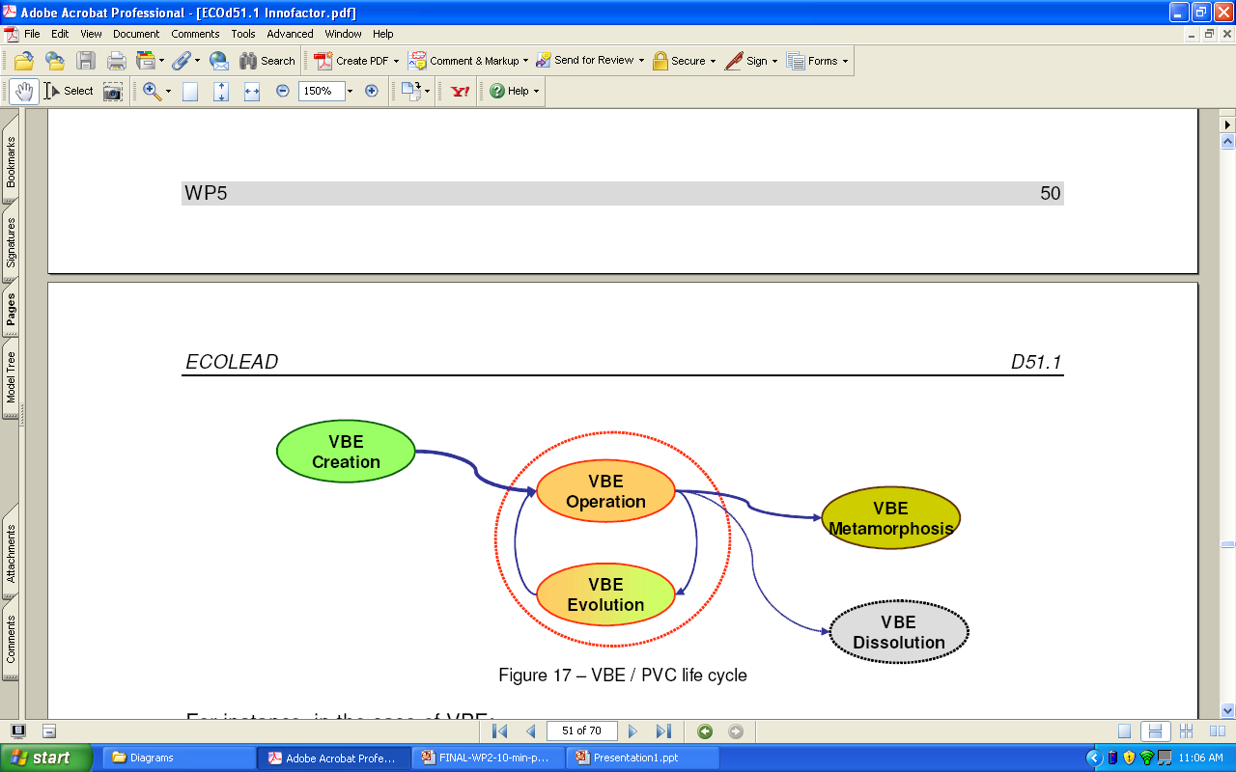
Operational aspects of CNs – ICT and systems
Life cycle of a short term goal oriented network
Modeling the CN life cycle and developing functionality as well as tools to support the management of networks during the entire life cycle
Life cycle of a long term strategic alliance

Slide 10






Lenses of collaborative networks
?
Collaborative networks need to be addressed as a multi-disciplinary scientific discipline
Governance lens
ICT lens
Collaborative network
Legal aspect lens
Economy and finance
lens
Health lens

Slide 11
Some 1st generation networks in Tanzania
SIDO
VETA
UKWATA?
CCM?

Slide 12
Long-Term Collaborative Networks
Lecture 2

Slide 13
Introduction to collaboration networks
An alliance constituting a variety of organizations:
  Largely autonomous, and geographically distributed,
  Heterogeneous (operating environment, culture, social capital)
  Collaborate to better achieve common goals,
  Interactions are supported by the computer networks
Why collaboration:
  Effectively achieving common goals
  Provision of cost effective solutions
  Complementation for competencies and resources
  Sharing of risks
Differentiating aspects of collaborative networks:
  Structural forms
  Duration
  Behavioral patterns
  Interaction forms

Slide 14
Establishing short term collaborative networks

Slide 15
Classes of collaborative networks

Slide 16
COLLABORATIVE NETWORK
A Collaborative Network is an alliance constituting a variety of entities (e.g. organizations and people) that are largely autonomous, geographically distributed, and heterogeneous in terms of their: operating environment, culture, social capital, and goals that cooperate/collaborate to better achieve common or compatible goals, and whose interactions are supported by the computer network.
  Cooperation/collaboration in a CN is an intentional property that derives from the shared belief that together the network members can achieve goals that would not have been possible or would have had a higher cost if attempted individually.

Slide 17
Types of collaborative networks
Differentiating aspects of collaborative networks:
  Structural forms
  Duration
  Behavioral patterns
  Interaction forms
  Membership
Duration indicate whether the collaborative network is a long-term or short-term
Membership will indicate whether the collaborative network constitute organizations or individuals as members

Slide 18
COLLABORATIVE NETWORKS
Collaborative Networks
CN with Individual members
CN with organization members
Short-term
Long-term
Short-term
Long-term
Virtual teams
(VT)
Professional
Virtual
Communities
(PVC)
Virtual
Organizations
(VO)
Virtual organization
Breeding
Environments
(VBE)

Slide 19
MOTIVATION TO JOINING COLLABORATIVE NETWORKS
Organizations are now operating in:
- very competitive market
- global and liberal market
- dynamic and changing customer demands
- market with increasing resources scarcity
- market with increasing opportunity volatility
Organizations need to collaborate in order to:
  enhance the chance of acquiring business opportunities
  sustain the survivability in the business world through collaboration
  fill their gaps in terms of resources and competency by using those of others
To survive

Slide 20
Collaborative networks of Organizations
Long term collaborative network of organizations
  Represents all form of collaboration involving organizations that will exist for a long time
  There is usually no immediate opportunity target
  They always focus on preparing members to act together when an opportunity emerges
  Preparation is usually on acquisition of technologies that are potential for collaboration
  Such type of collaborative networks are referred to long-term strategic alliance of organizations

Slide 21
Collaborative networks of Organizations
Short term collaborative network of organizations
  Represents all form of collaboration involving organizations that will exist for a short time
  There are usually created involving members from a long-term strategic alliance.
  They are created to address already acquired opportunity
  Such type of collaborative networks are referred to short-term consortiums

Slide 22
Collaborative networks of Organizations
Consortium
Alliance
Consortiums are usually created within alliances

Slide 23
Collaborative networks of Organizations
Short-term consortiums are scientifically referred to as Virtual Organization - VO
A VO is an association of (legally) independent organizations (VO partners) that come together and share resources, and skills to achieve a common goal, such as acquiring and responding a market/society opportunity

Slide 24
Collaborative networks of Organizations
Long-term strategic alliances are scientifically referred to as Virtual Organization Breeding Environment- VBE
An association of organizations
And related supporting institutions,
adhering to a
base long term cooperation agreement,
and adoption of
Common operating principles and infrastructures,
with the main goal of
increasing their preparedness
towards collaboration
in potential Virtual Organizations
Transition from
Point to point connections
To
Network structure
To increase the chances of involvement in business opportunities

Slide 25
VBE and VO
VO
VBE
Open Universe

Slide 26










Virtual Organization Breeding Environments
Ready
to
collaborate
!
“
Open universe”
VBE
of
organizations
Environment
1.a
Getting
ready
to
collaborate
Cooperation agreement
•
Common infrastructure
•
•
Common
principles
•
Base
trust
VO
1.b
Creation
in
VBE
Collaboration
•
VO
planning
Opportunity
•
VO partners selection
•
Fast
contract
negotiation
•
VO
setup
2
Open
VO
creation
Wide partners’ search & selection
•
Establish common infrastructures
•
•
Common
principles
•
VO
planning
Goal
-
•
VO
partner
selection
VO
oriented
Collaboration agreement
•
•
Contract
negotiation
•
VO
setup
•
Base
trust

Slide 27
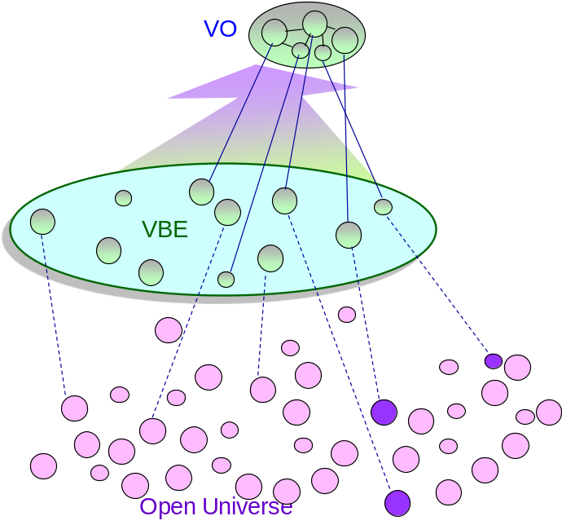
Management Virtual Organization Breeding Environments
A number of aspects must addressed to enhance the establishment and management of VBEs:
  Competence management
  Trust management
  Performance management
  ICT infrastructure management
  Information system management
  Record management
  Cooperation management
  Readiness

Slide 28
VBE life cycle phases

Slide 29
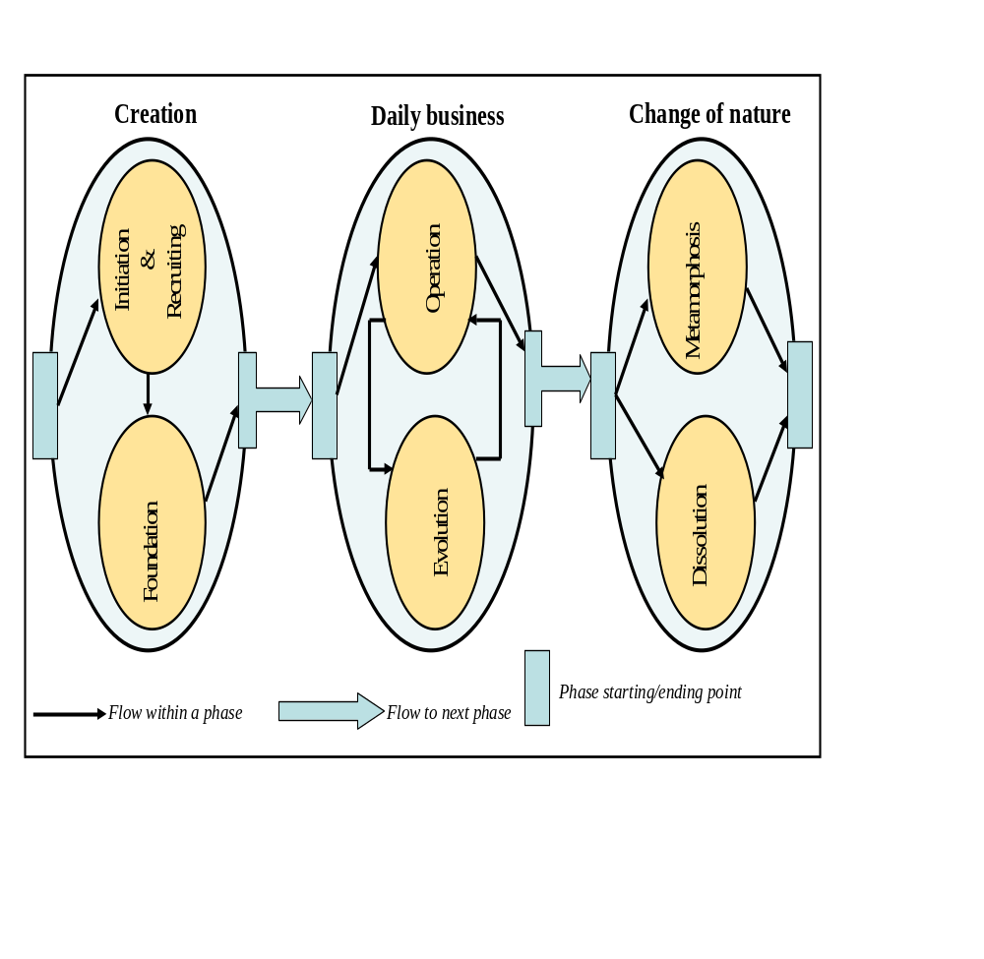
VBE life cycle phases – Creation Phase
During the initiation & recruiting sub-phase, the VBE administration performs (or supports the performance of) the following main activities: setting up & running the VBE management system and ICT- tools, loading existing ontology & thesaurus, setting up domain parameters & nodes, and so on. During the foundation sub-phase, the VBE administration performs (or supports performing) the following main activities: adapting the VBE ontology, adapting database schema and creating repositories & interfaces for database access, entering administrative data, and registering founding members.

Slide 30
VBE life cycle phases – Daily business Phase
Operation Phase: During this phase many collaborative activities, such as repetitive acquisitions of and responses to business opportunities, are performed in the framework of achieving the VBE objectives
When mirror changes has to be made within the VBE then it undergoes evolution sub-phase

Slide 31
VBE life cycle phases – change of nature Phase
the metamorphosis phase - where it can undergo a major evolution that changes its form and purpose
dissolution phase – the closure of the VBE

Slide 32
Example VBEs
VETA
SIDO
TATO
IECOS - Mexico
CEBENETWORK - Germany
HELICE Foundation– Spain

